Slide 1
Employee Data Analysis using Excel
STUDENT NAME:ANAKHA A R
REGISTER NO:2213211036032/unm13212213211036032
DEPARTMENT: BACHELOR OF COMMERCE(GENERAL)
COLLEGE: PRESIDENCY COLLEGE(AUTONOMOUS),CHENNAI

Slide 2
PROJECT TITLE
Employee Salary Analysis
Using Excel

Slide 3


AGENDA
Problem Statement
Project Overview
End Users
Our Solution and Proposition
Dataset Description
Modelling Approach
Results and Discussion
Conclusion
3/21/2024 Annual Review

Slide 4

PROBLEM STATEMENT
This analysis aims to investigate the demographic and professional characteristics of employees within the organization and understand the distribution of salaries. The specific objectives include:
Analyzing the salary distribution across different genders.
We are identifying any trends or disparities in salaries based on education level, job title, years of experience, and other demographic factors.
It is providing insights that can inform decisions on salary equity and diversity initiatives.

Slide 5

PROJECT OVERVIEW
Objective: Analyze employee data to identify trends in demographics, job roles, and salary distribution. The goal is to uncover potential disparities and provide actionable insights for HR policies and compensation strategies.
Scope:
Data Analysis: Evaluate salary distribution by gender, education, race, job title, and experience.
Equity Focus: Identify and address any disparities in compensation.
Reporting: Summarize findings with visualizations and recommendations.
Outcome: Insights to enhance fair compensation and support diversity initiatives.
.

Slide 6

WHO ARE THE END USERS?
Human Resources Department: They would use the analysis to ensure equitable salary practices and make informed decisions regarding employee compensation, promotions, and diversity initiatives.
Senior Management: They need insights into salary distributions and demographic trends to guide strategic decision-making, particularly regarding workforce management and budget allocation.
Diversity and Inclusion Committee: This group would focus on the equity aspects of the analysis, using the data to support initiatives aimed at promoting diversity and inclusion within the organization.
Compensation Analysts: They would utilize the findings to benchmark salaries and assess the competitiveness of the organization's compensation structure.
Employee Relations Team: This team may use the analysis to address concerns related to salary disparities and to foster a transparent and fair workplace environment.

Slide 7
OUR SOLUTION AND ITS VALUE PROPOSITION
Solution:
1.Comprehensive Employee Demographics & Salary Analysis
2.Analyze employee data to uncover salary trends, identify disparities, and support equitable compensation practices. This analysis empowers HR and management to make informed, fair, and strategic decisions, enhancing diversity and inclusion efforts while ensuring competitive compensation.
Value Proposition:
Informed Decisions: Equip HR and management with data-driven insights for fair compensation and strategic workforce planning.
Promote Equity: Identify and address salary disparities, ensuring fairness and boosting employee satisfaction.
Support Diversity: Provide actionable data to enhance diversity and inclusion initiatives, fostering a more inclusive workplace.
Competitive Edge: Benchmark salaries to attract and retain top talent with competitive compensation packages.
Risk Mitigation: Proactively reduce legal risks by ensuring equitable pay practices.

Slide 8
Dataset Description
Age: The age of each employee.
Gender: The gender of each employee (e.g., Male, Female, Other).
Education Level: The highest level of education attained (e.g., Bachelor's, Master's, PhD).
Job Title: The current job role or title of the employee.
Years of Experience: The total number of years the employee has worked.
Salary: The annual salary of the employee.
Country: The country where the employee is based.
Race: The racial or ethnic background of the employee.
RAW DATA Sheet: Contains the detailed, individual-level data for each employee
ANALYSIS Sheet: Summarizes total salary figures by gender, providing a high-level overview of salary distribution across the organization.

Slide 9
THE "WOW" IN OUR SOLUTION
Holistic Insight: The Excel sheet provides a comprehensive view of the organization’s workforce, combining demographic, professional, and compensation data. This allows for deep, multi-dimensional analysis, revealing insights that go beyond surface-level statistics.
Equity and Diversity Focus: The dataset enables a focused analysis on equity and diversity, making it possible to identify and address any potential disparities in salary. This empowers the organization to take actionable steps towards fostering a fair and inclusive workplace, which is a significant value-add in today’s corporate environment.
Actionable Data: The summarized analysis in the sheet provides clear, actionable insights for decision-makers, allowing them to swiftly implement changes that can have a positive impact on employee satisfaction and organizational culture.

Slide 10
MODELLING
1. Identify Key Variables:
Dependent Variable (Outcome): This is what you're trying to predict or explain. Look for columns in the sheet that might represent an outcome or result.
Independent Variables (Predictors): These are the factors that might influence or predict the outcome. They could be metrics like age, income, time, etc.
2. Look for Formulas or Calculations:
If there are any columns in the "ANALYSIS" sheet with formulas, these could represent the relationships or models used to predict outcomes based on other variables.

Slide 11
MODELLING
3. Determine the Type of Modeling:
Regression Analysis: If the sheet contains linear or multiple regression calculations, the model might be trying to predict a numerical outcome based on one or more predictors.
Classification: If the sheet categorizes data into groups (e.g., yes/no, high/low), it might involve a classification model.
Time Series Analysis: If the data is sequential over time, the modeling might be related to forecasting future values based on past trends.
4. Review the "ANALYSIS" Sheet:
This sheet might contain summaries or insights derived from the "RAW DATA" sheet. Look for any statistical summaries, charts, or key metrics that indicate what the analysis is focused on.
5. Descriptive Information:
Sometimes, there might be notes or headers that explain the purpose of the analysis or the key factors being modeled.

Slide 12
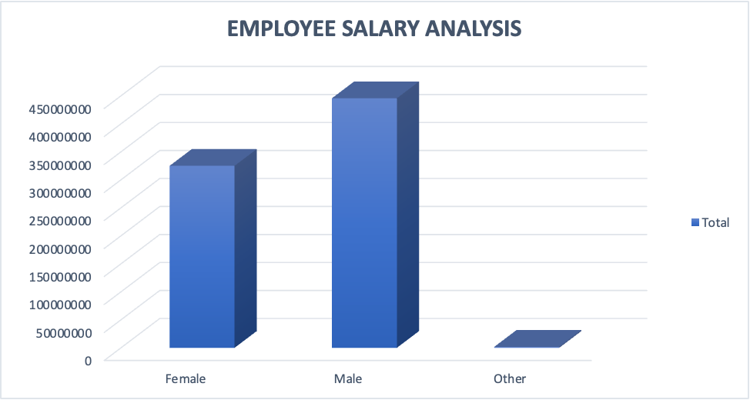
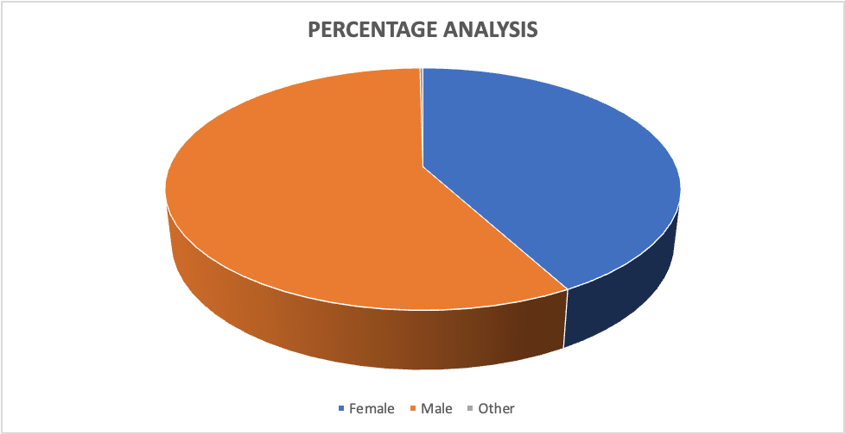
RESULTS

Slide 13
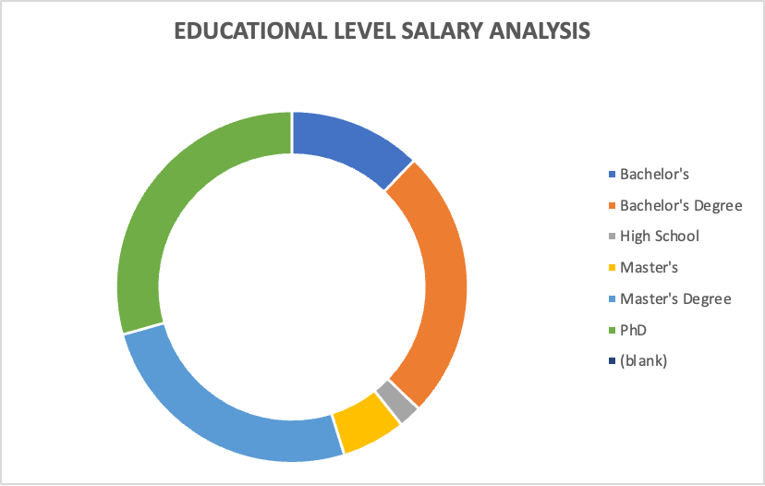
RESULTS

Slide 14
conclusion
"Our comprehensive analysis of employee salaries has provided key insights into the distribution of compensation within the organization. The data highlights significant trends, such as disparities in pay across departments, experience levels, or gender. These findings underscore the importance such as implementing a more equitable pay structure or investing in professional development for under-compensated groups.
Moving forward, our organization should focus on addressing these disparities to ensure fair compensation practices, which will not only enhance employee satisfaction but also strengthen our overall organizational performance. Continuous monitoring and periodic review of salary structures will be essential to maintaining fairness and competitiveness in the market."

